Slide 1



More Attempts Using BS (beautiful soup), reaching out Via Reddit, and using’s someone's Repo
By Juan Villegas
3/8/23

Slide 2
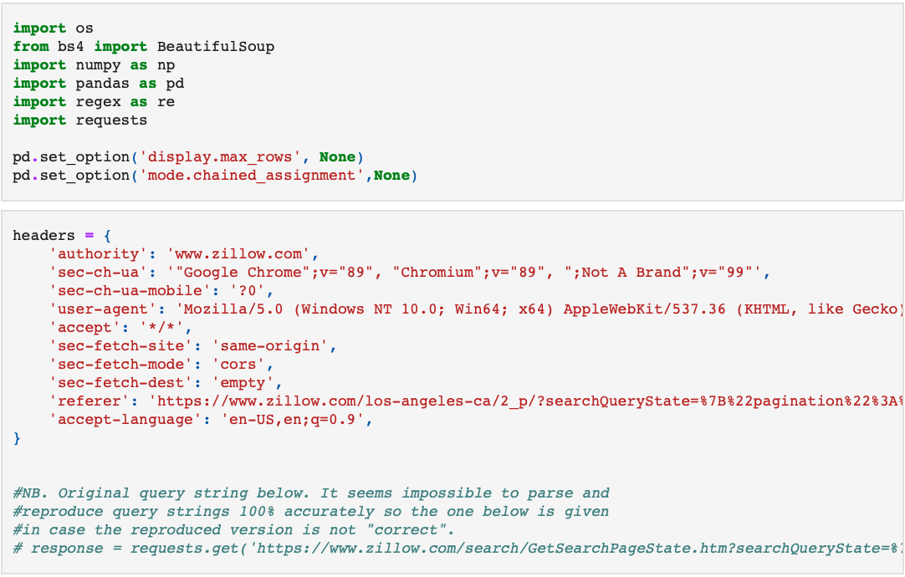
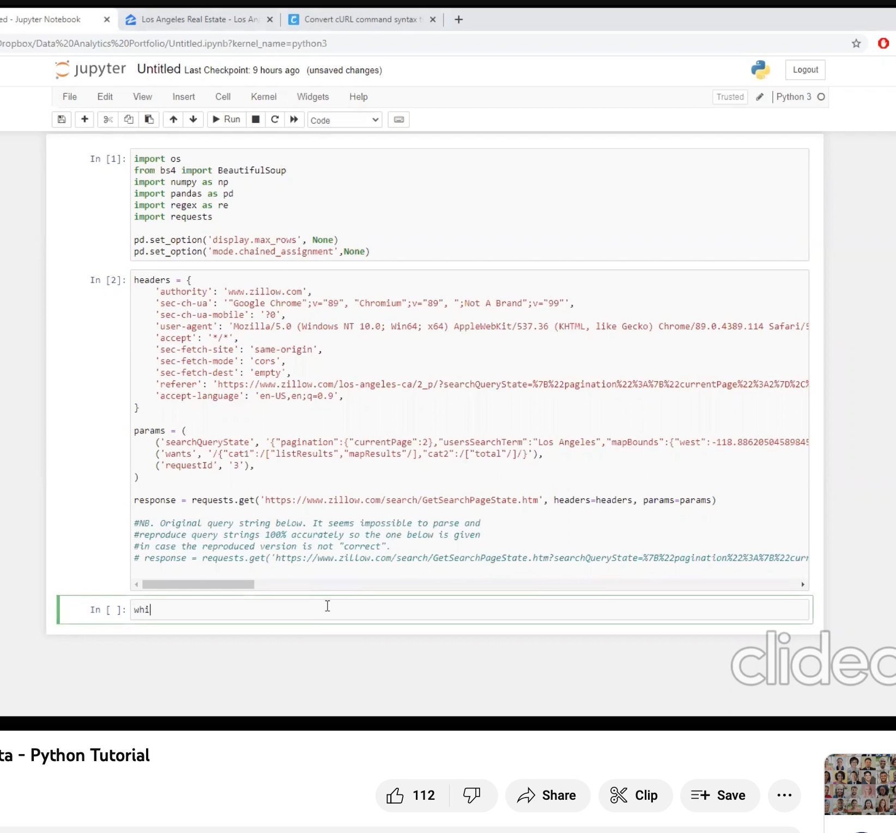
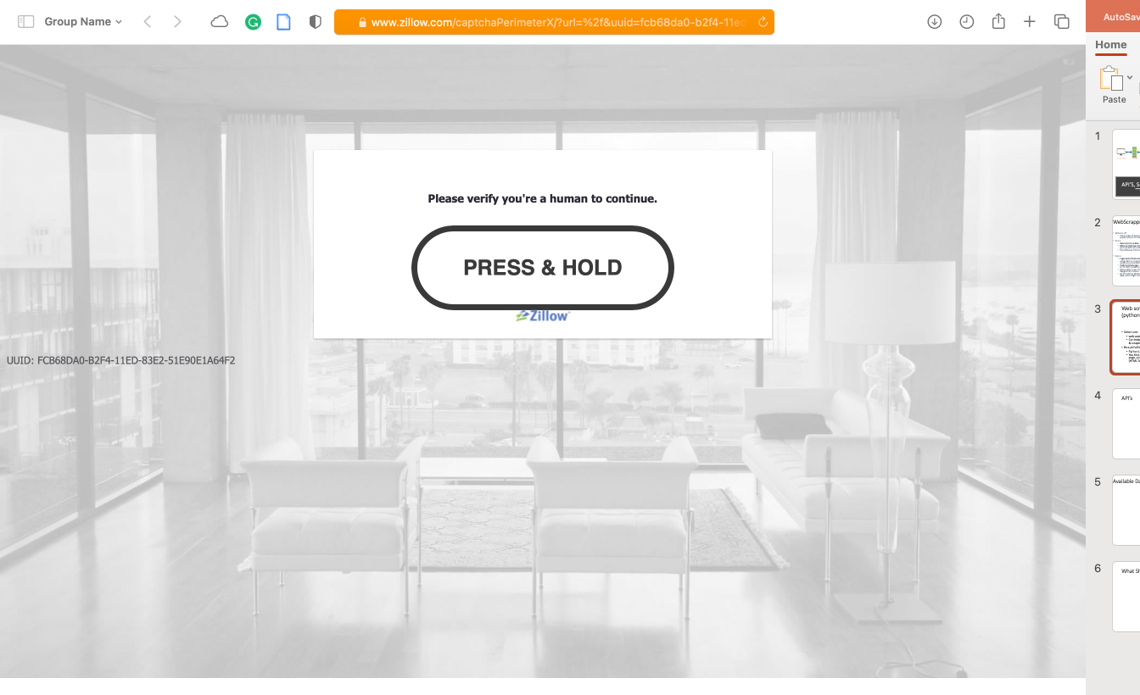
Youtube
Attempted to follow along videos using Youtube:
Using just Beuatiful soup became complicated quick
Tried going back to BS + Selenium (how I originally started)… was blocked immediately
Gave up on trying to do it on my own

Slide 3
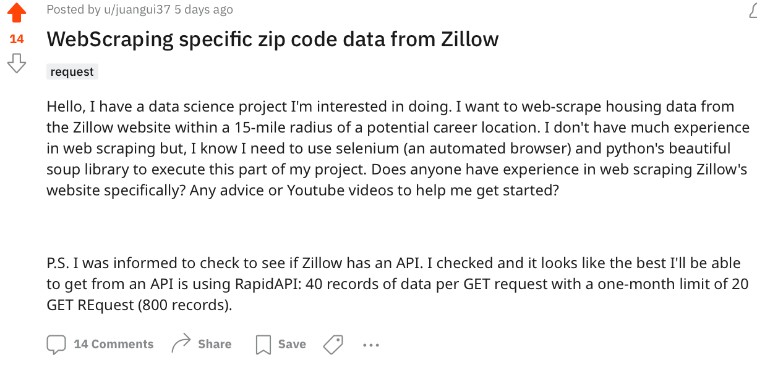
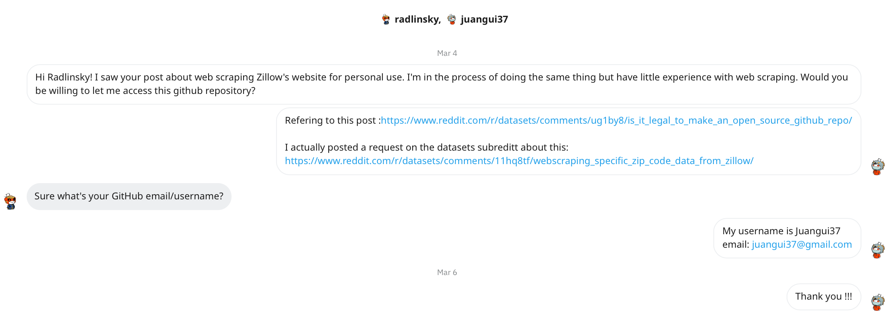
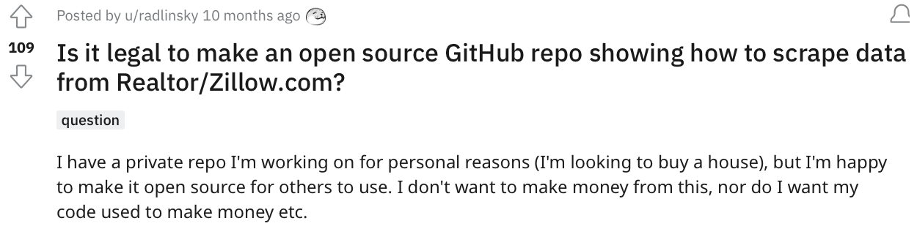
Reached out to online communities (HELP!)
1st, I searched the ‘datasets’ subreddit to see if anyone had made this question…
2nd, I asked a question on the subreddit making it more specific about my wants and needs
3rd, I reached out to the person that I saw did something similar to me asking him for his repo.
4th, The guy messaged me back a day later and privately shared it with me

Slide 4
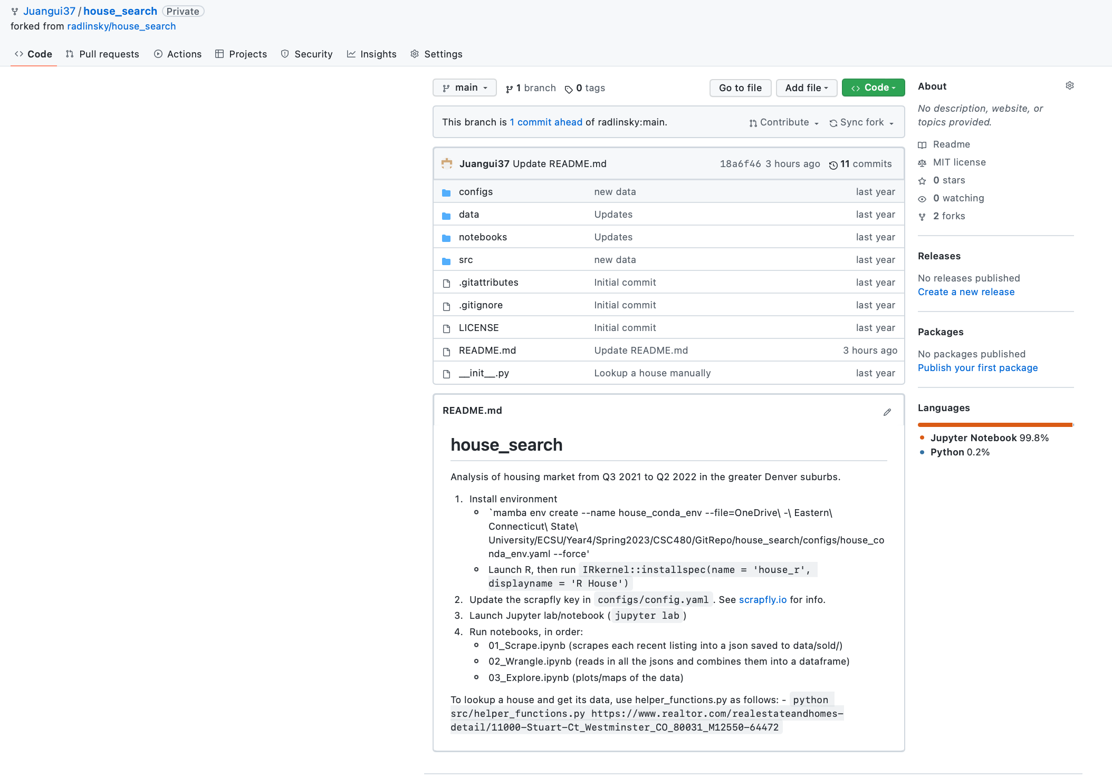
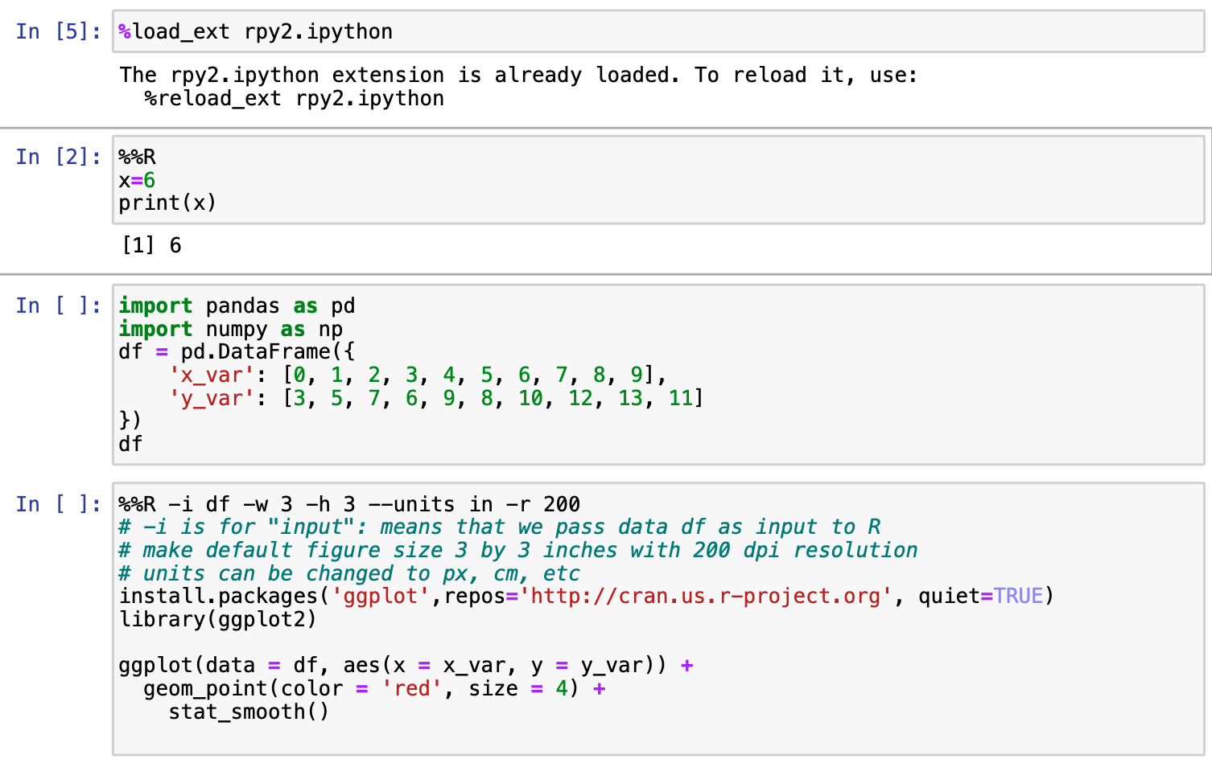
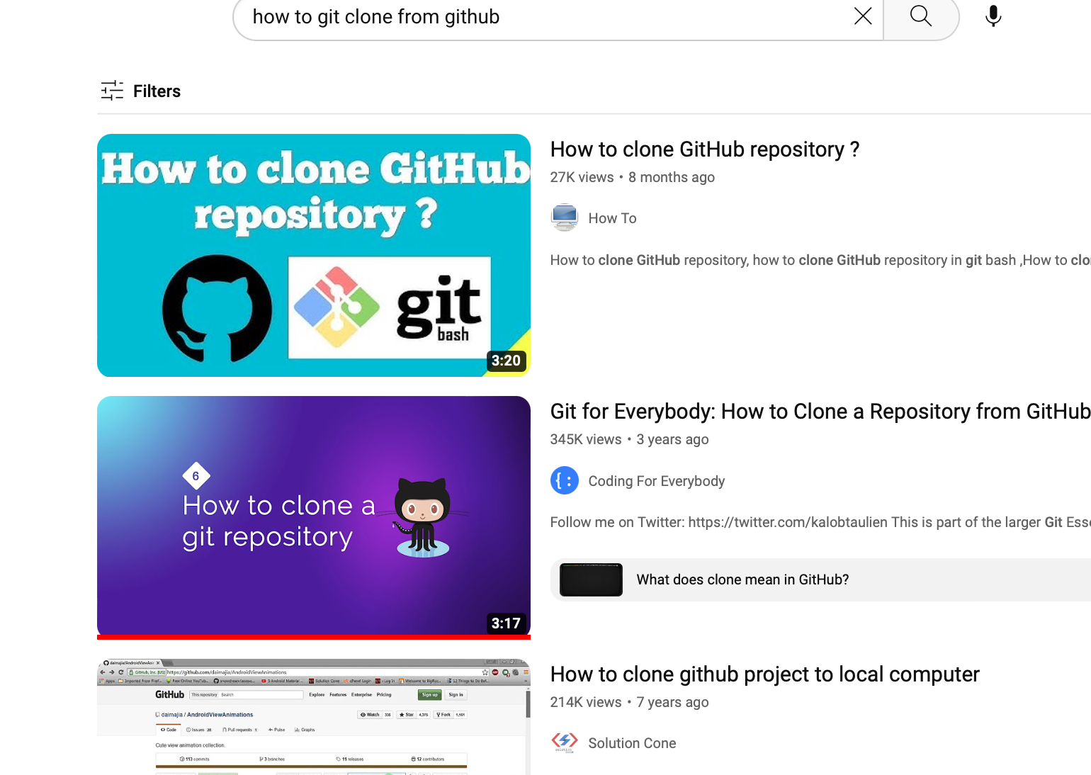
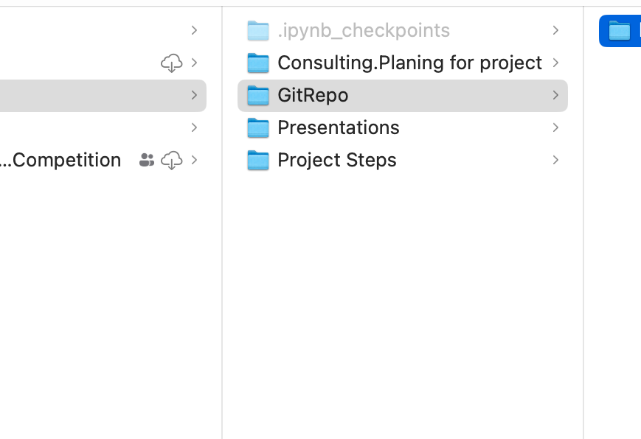
Forking, Cloning, and trying to follow the steps.
I learned how to fork and clone a repo into my local computer
I had to install Mamba, which is a much faster built in package manager
And I was trying to create an R kernel inside of Jupyter notebooks
I made a scrapfly account & got my API key

Slide 5
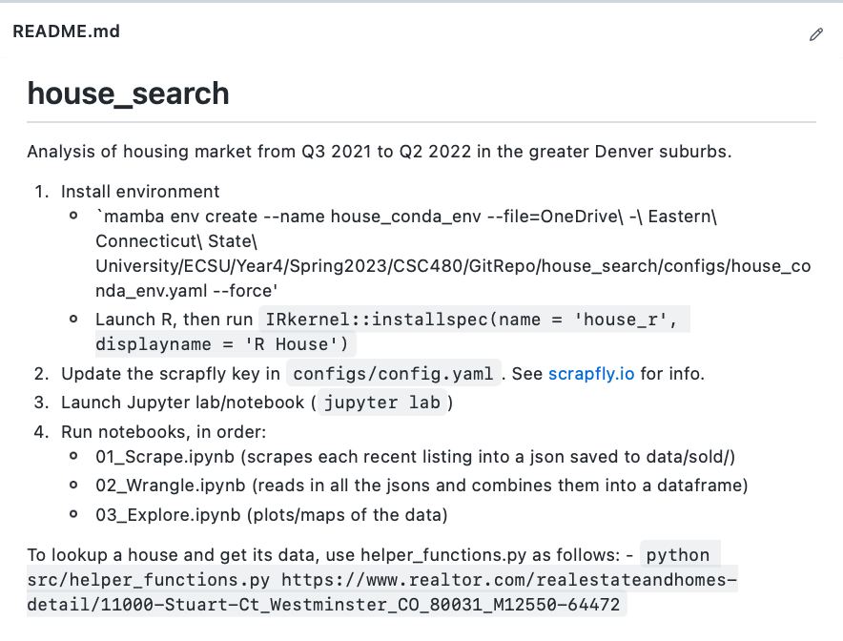

Slide 6

Questions
Do you guys know any students who can help me finish this part of the project?
If I cannot get the data by the end of spring break, what do you think I should do? Buy the data set? See if ChatGPT can generate a random dataset for me? Find an already established dataset?
If you where hypothetically a less technical person and was trying to scrape data and after trying realized how hard it was, when would you have given up?

